Slide 1
PRESENTATION ON
BAGS-CART (E-COMMERCE)
PRESENTED BY
Sirisha NB
Syed Waqeer
Farvej Kulmi
Sujan Prabhakar

Slide 2
PROBLEM STATEMENT
E-commerce provides an easy way to sell products to a large customer base. The purpose of E-commerce website is to help customers narrow down their broad ideas and enables them to finalize the products they want to purchase.

Slide 3
REQUIREMENT
FRONT END
React JS
Boot Strap
BACK END
Java
MySQL
Spring boot

Slide 4
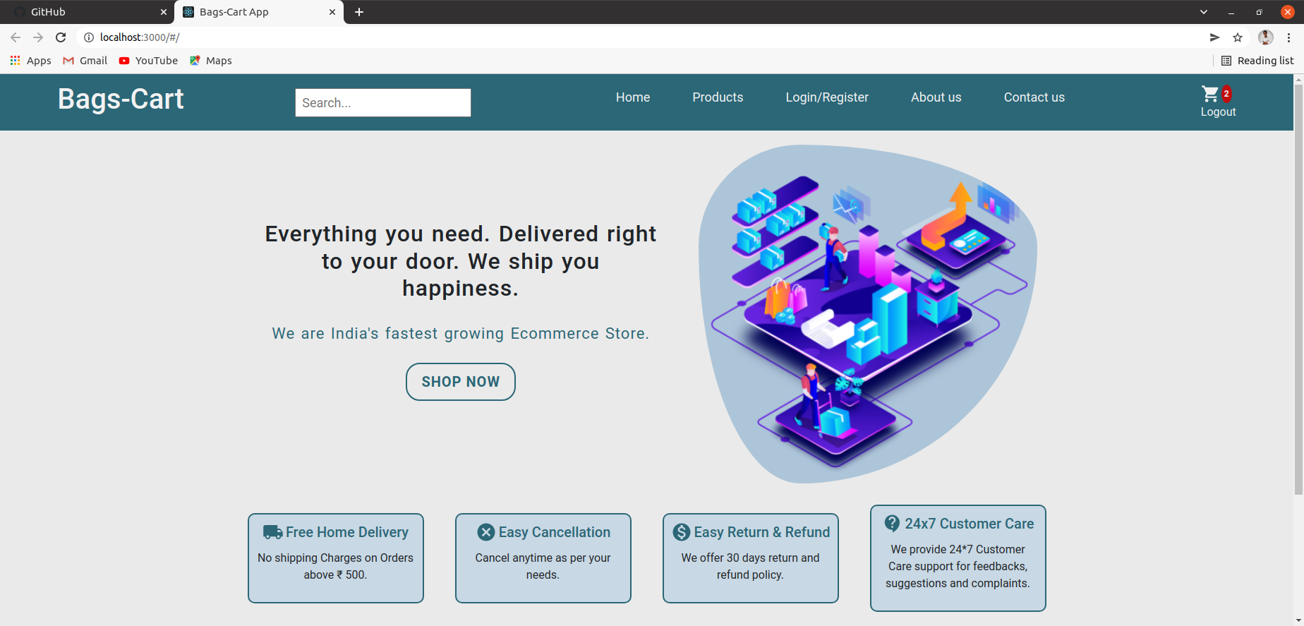
SCREENSHOTS
HOME PAGE

Slide 5
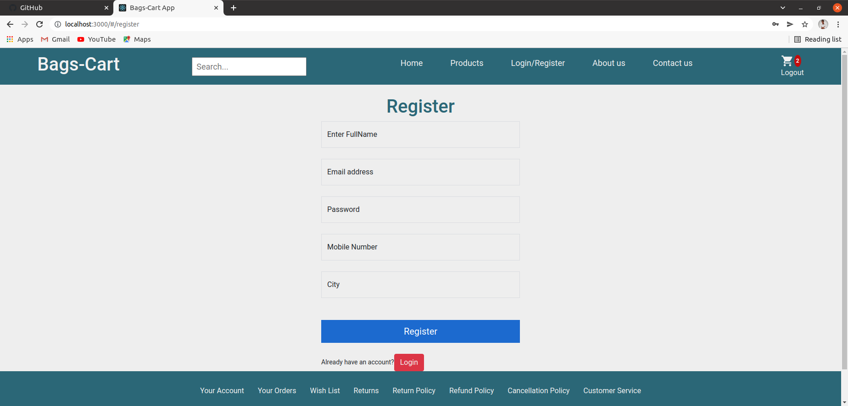
LOGIN PAGE

Slide 6
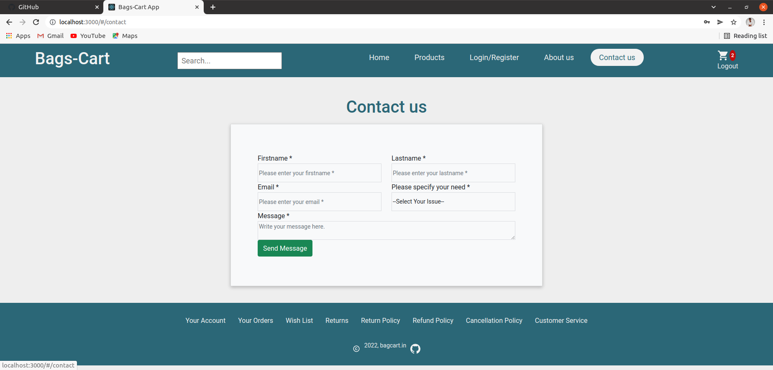

Slide 7
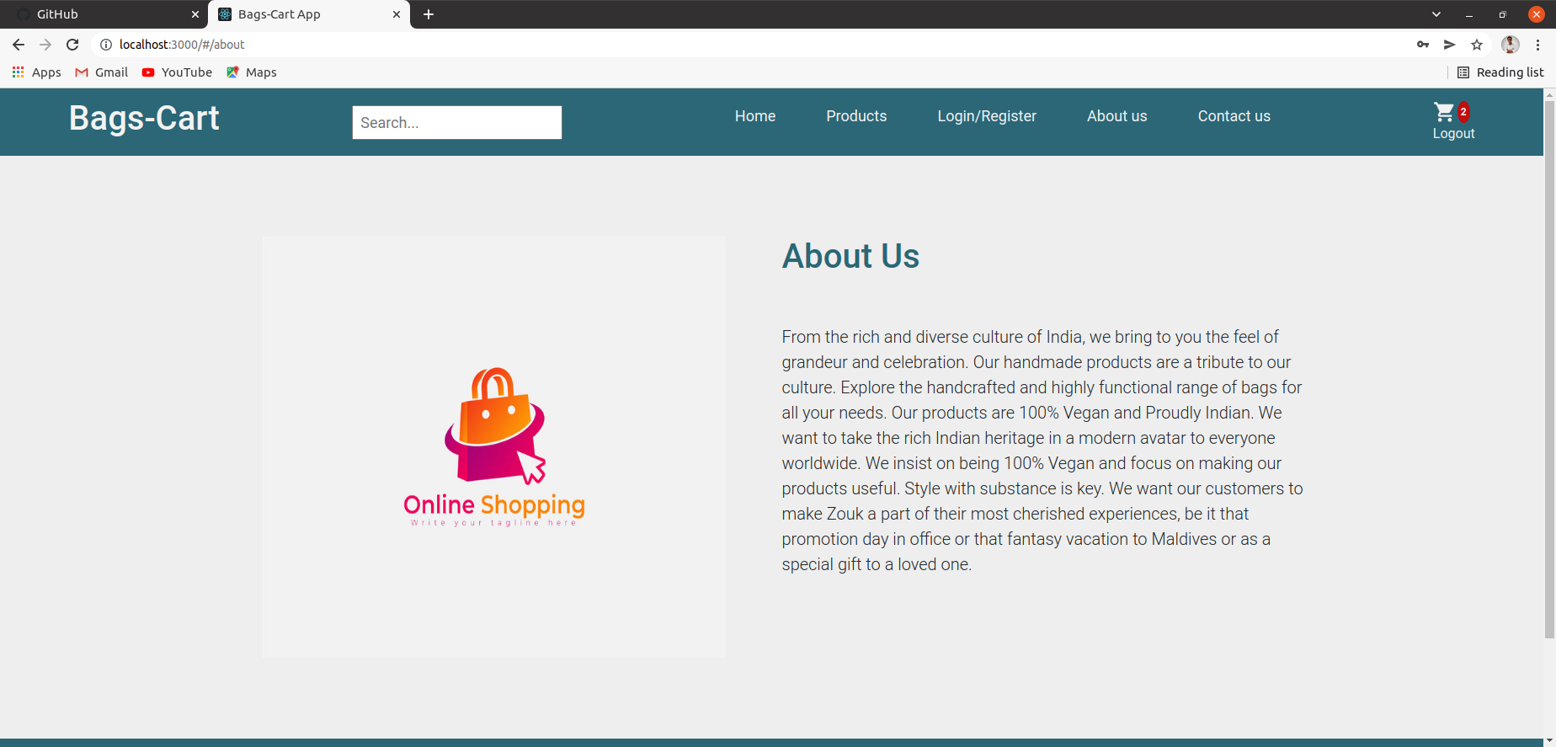
ABOUT US PAGE

Slide 8
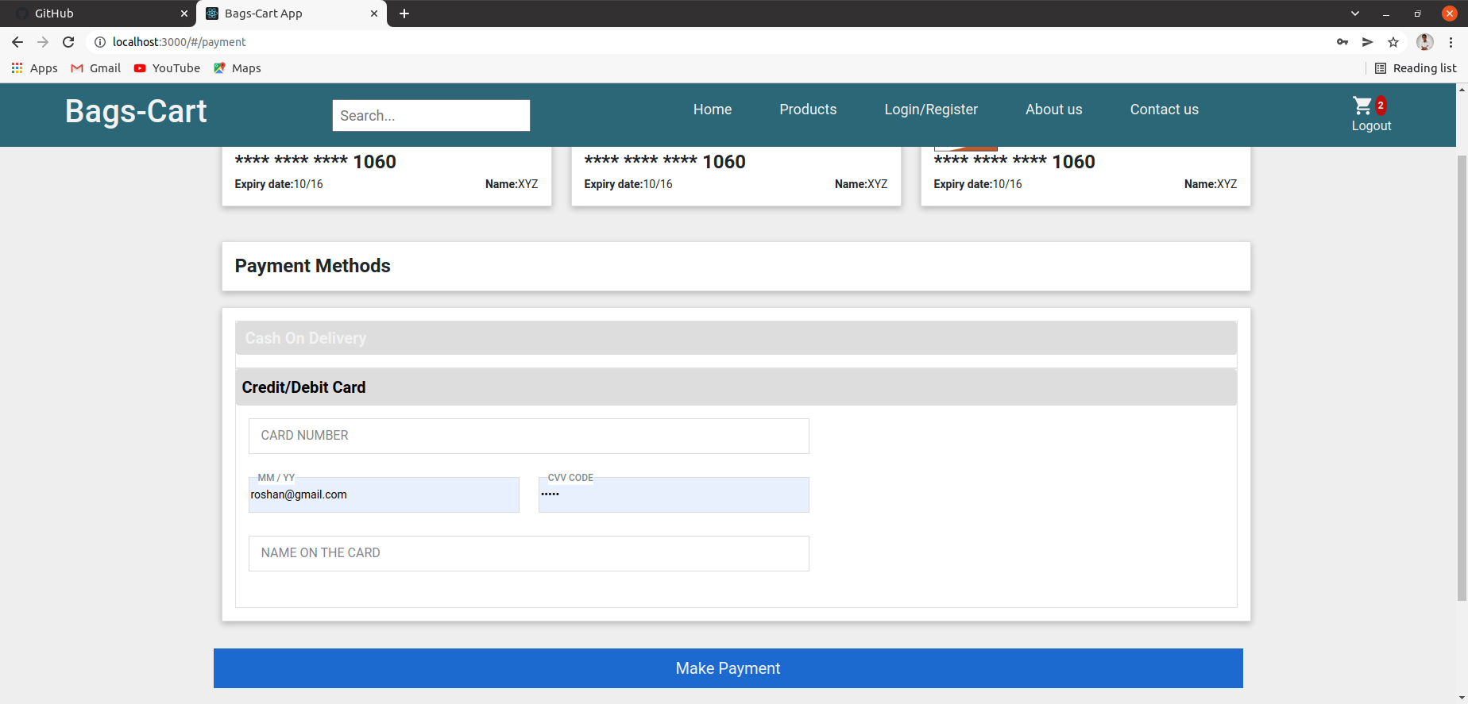
PAYMENT PAGE

Slide 9
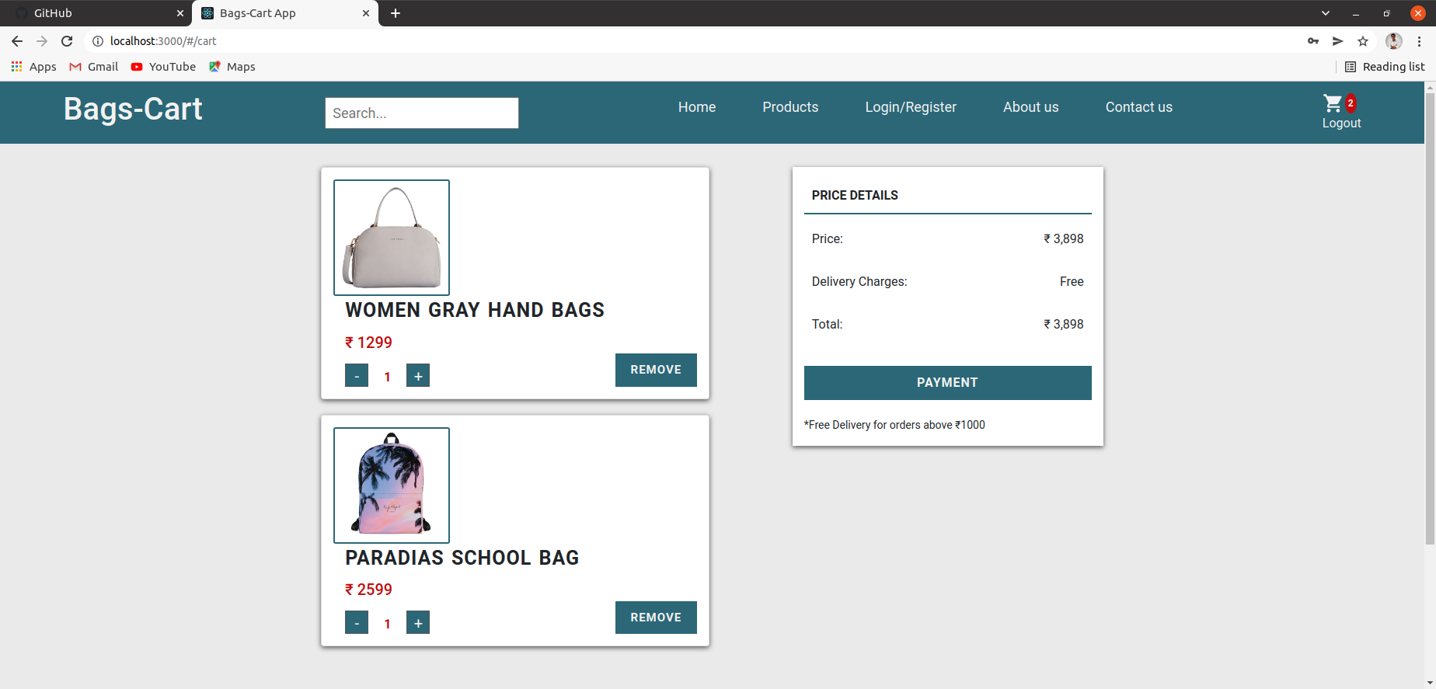
CART PAGE

Slide 10
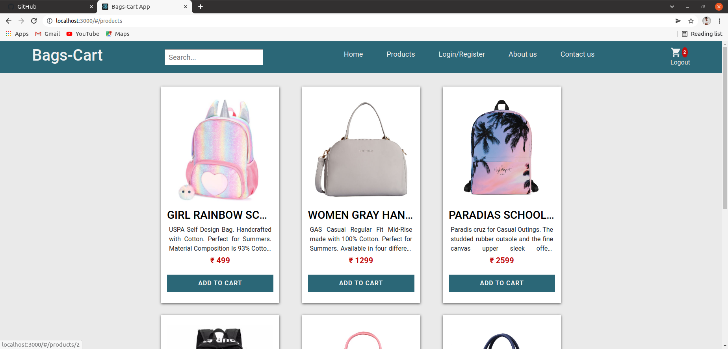
PRODUCTS PAGE

Slide 11
THANK YOU

